Slide 1

CHRISTOPHER BARAZA
TIFFANY JONES
RICK MARTINEZ
BELLE MOYA

Slide 2

Sources
“If you only knew the power of the dark side.” — (The Empire Strikes Back)
SWAPI (https://swapi.dev/)
OMBD (https://www.omdbapi.com/ )

Slide 3

Extract
Both of our data sources came as APIs in JSON format. We worked in a combination of VS Code and Jupyter Notebook. Only OMDB required and api key.

Slide 4


Transform
From SWAPI we pulled the following information for the first 6 films
Title
Episode ID
Director
Release Date
Opening Crawl
From OMDB we pulled the following information for the first 6 films
Name
Actors
Metascore
Awards
Box Office Revenue
Runtime
DVD release date
“You must unlearn what you have learned.”
— (The Empire Strikes Back)

Slide 5

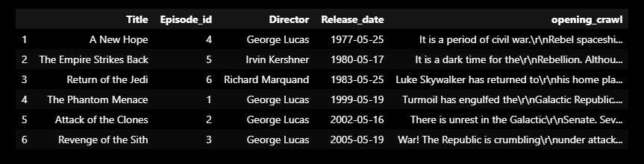
Swapi
We created a for loop to extract the following lists from SWAPI to create our new Dataframe for each movie that was available in our sources.

Slide 6

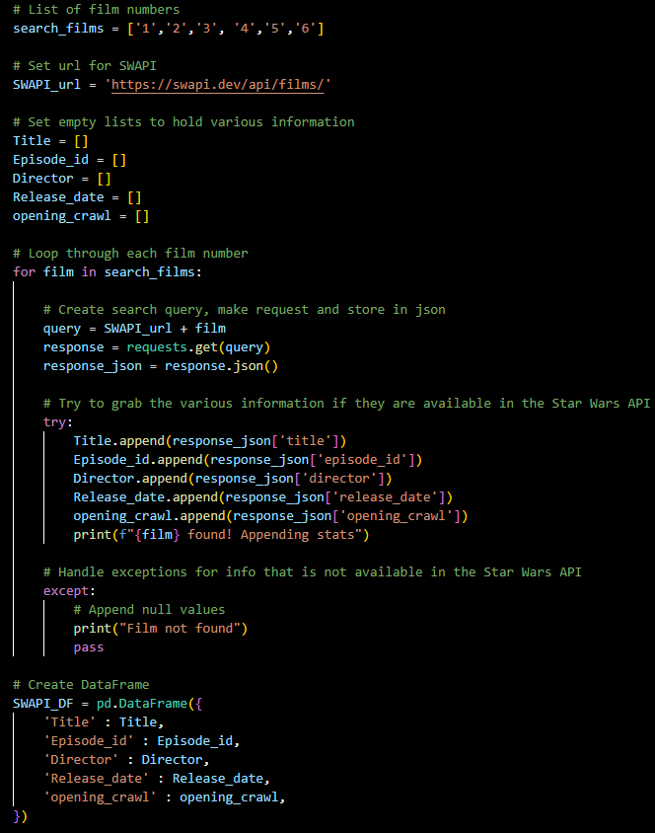

Slide 7
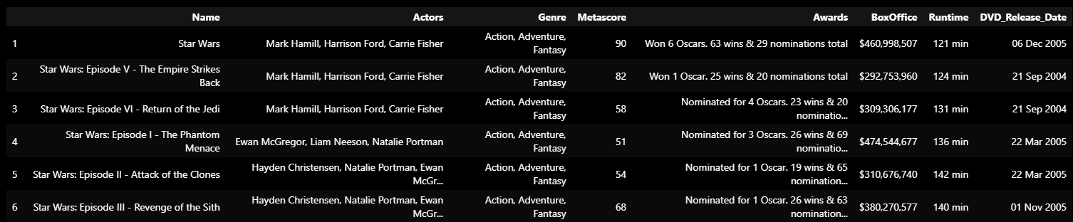
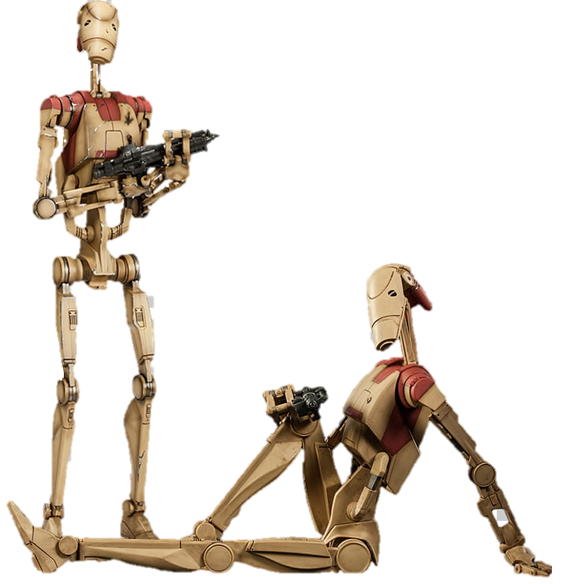
oMBD
We created a for loop to extract the following lists from OMBD to create our new Datframe form Episodes I – VI.

Slide 8

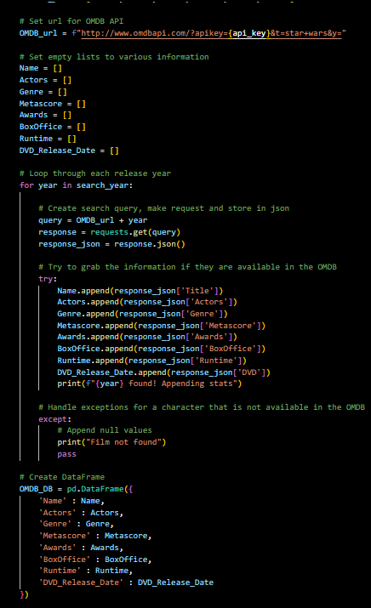

Slide 9
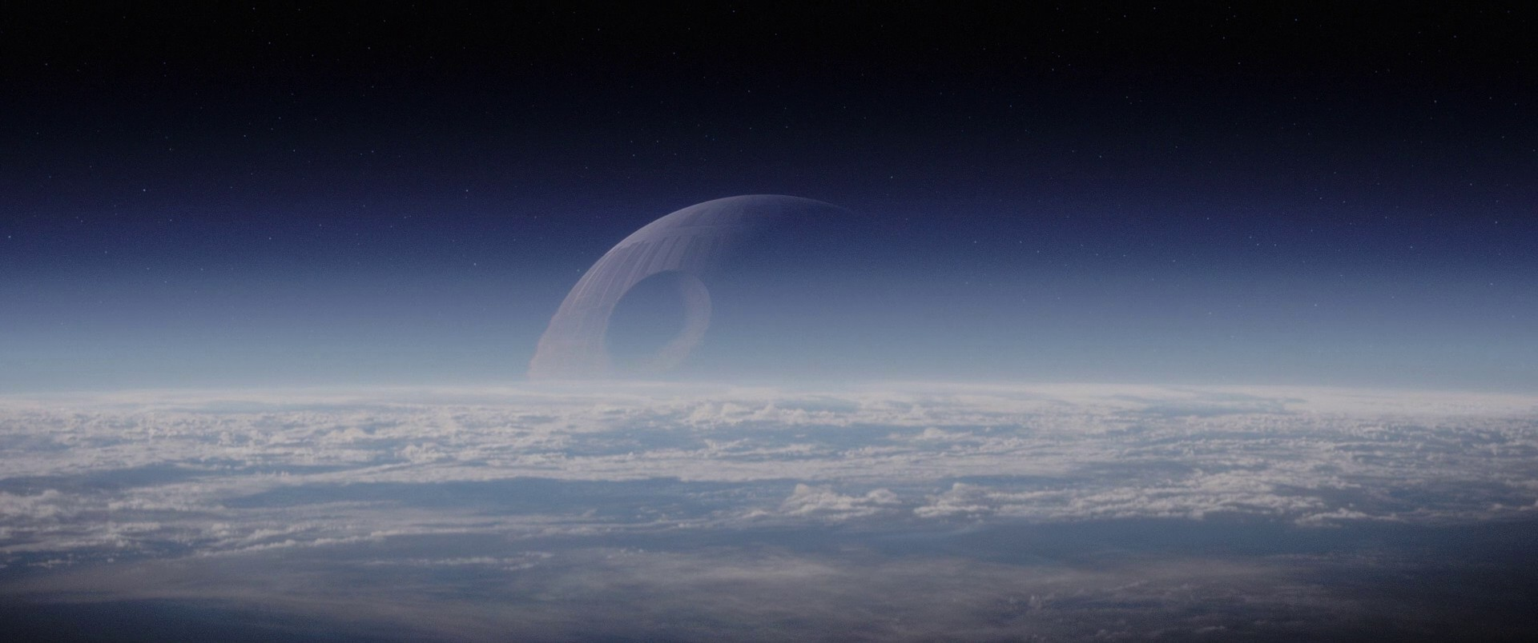
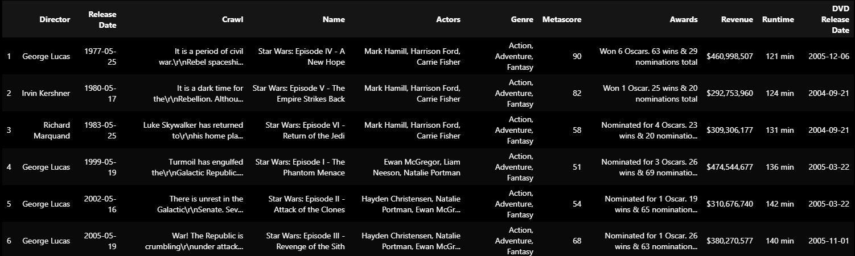
cleaning the code
After pulling both data frames, we created a temporary key between the two so that we could merge them together and ensure that the relevant movie information stay in the correct rows. We also cleaned up the layout by re-naming columns and re-arranging the table order.

Slide 10

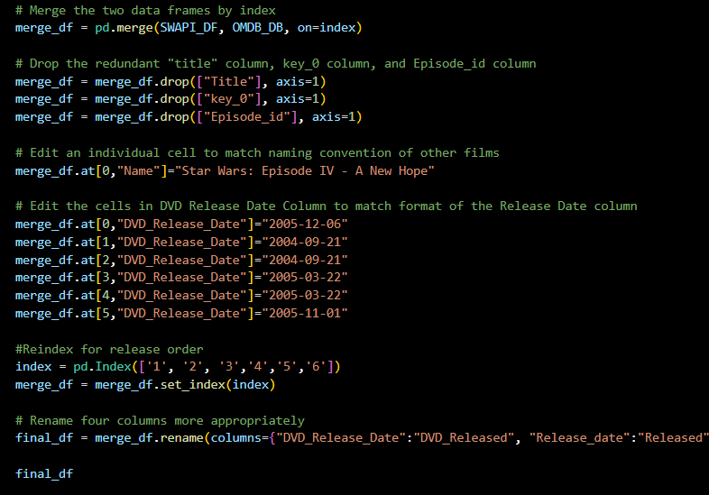
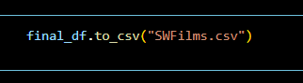
“Aren’t you a little short for a stormtrooper?”
The code below is creating our data frame into a csv..

Slide 11

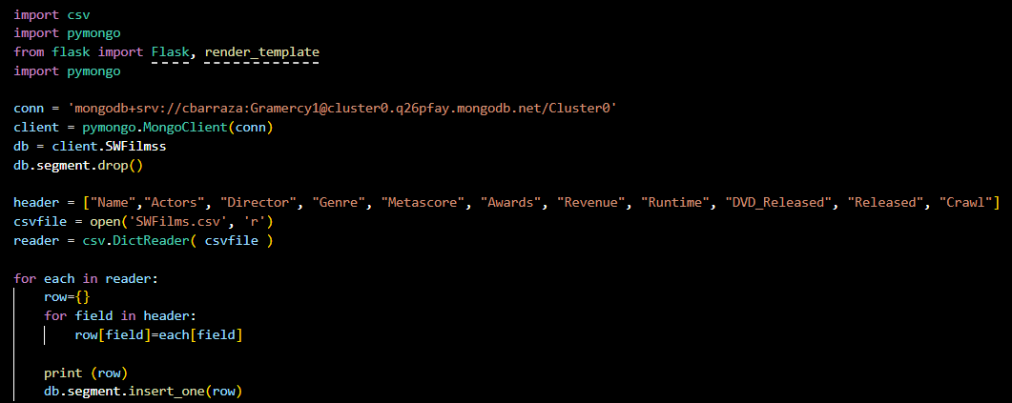
Mongo
This is the code we used to create our data frame through pymongo. We imported our dependencies, then created a connection to the client and wrote a for loop to pull out rows from the header. It printed out a dictionary of the following fields.

Slide 12
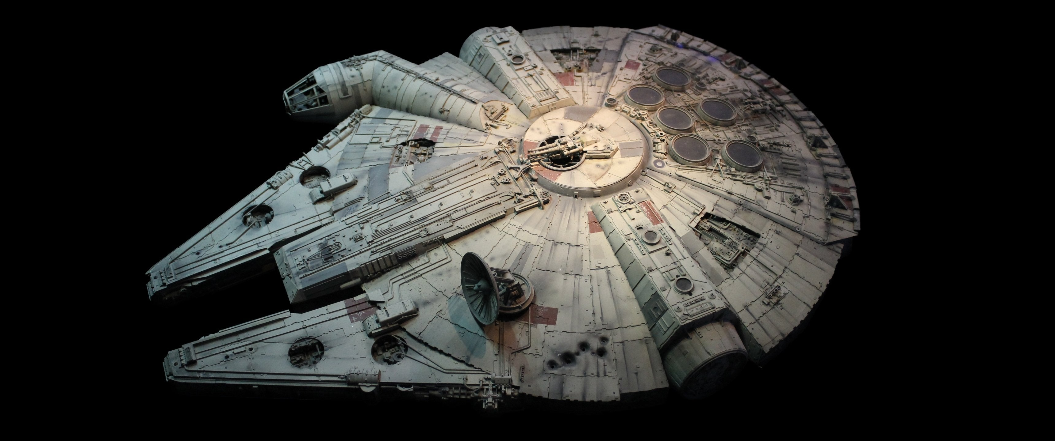
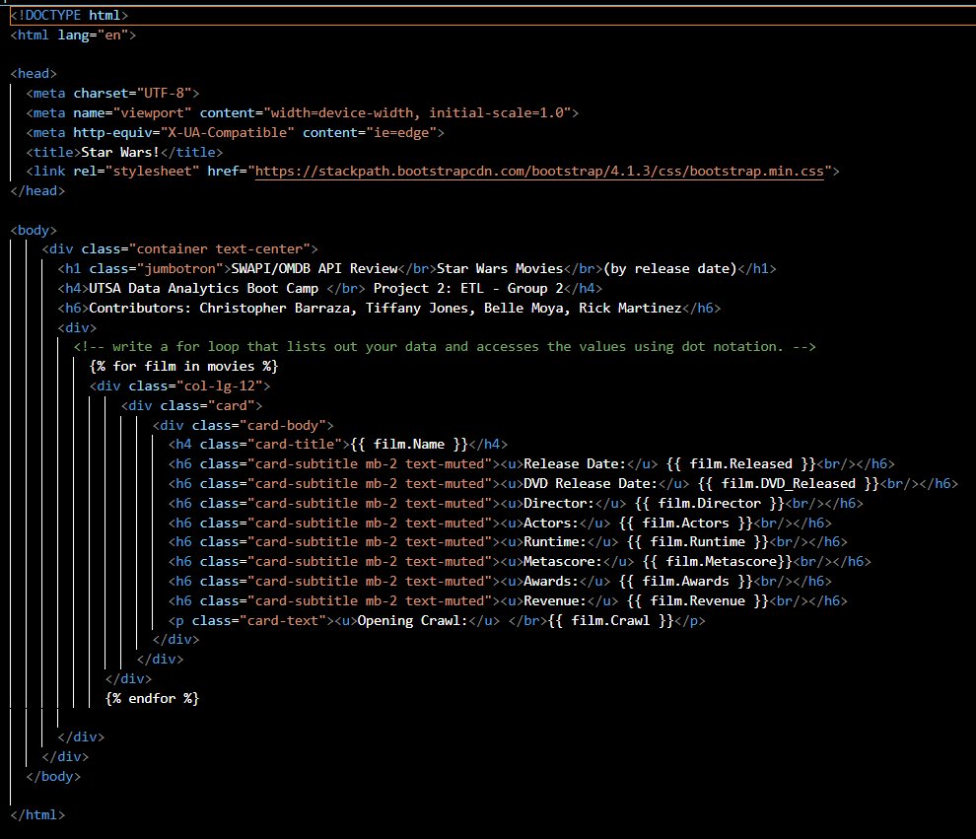
HTML
This is the html code that we used to create our page when pulled through flask.

Slide 13
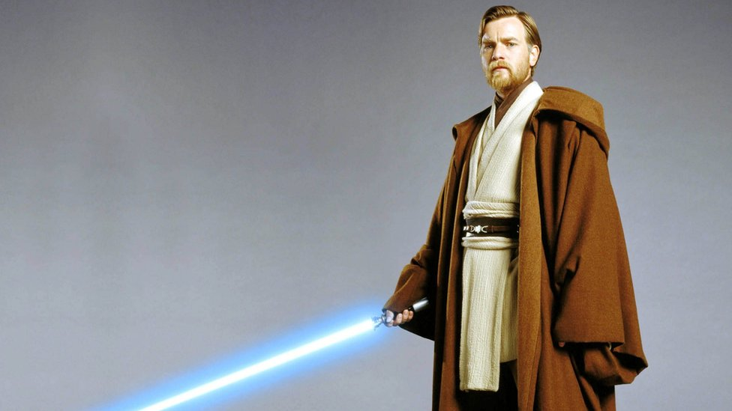
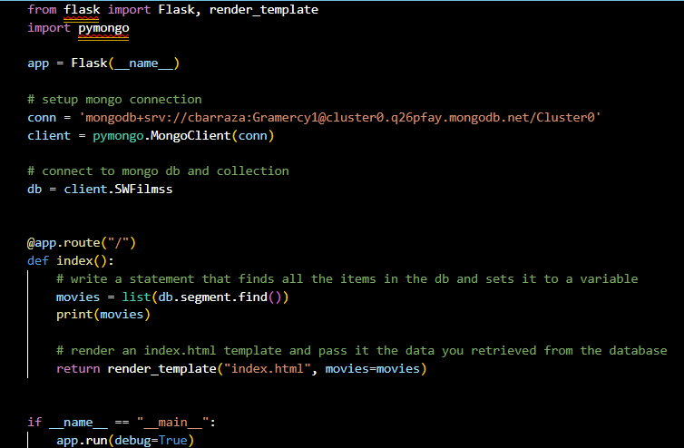
LoAdinG...
We loaded the data into a final database. http://127.0.0.1:5000/ using Flask
“Remember…the Force will be with you, always.” — (A New Hope)

Slide 14

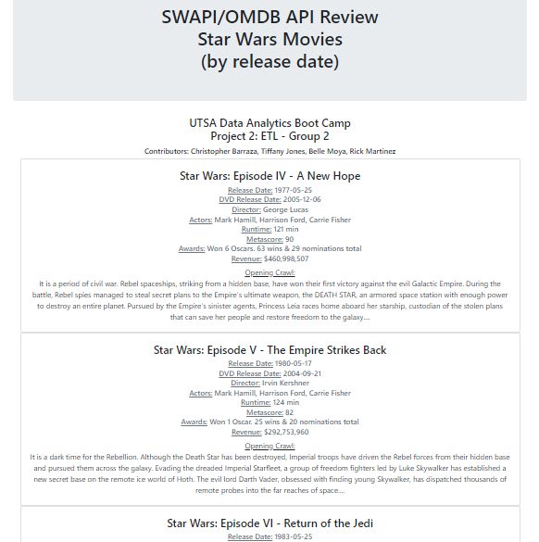
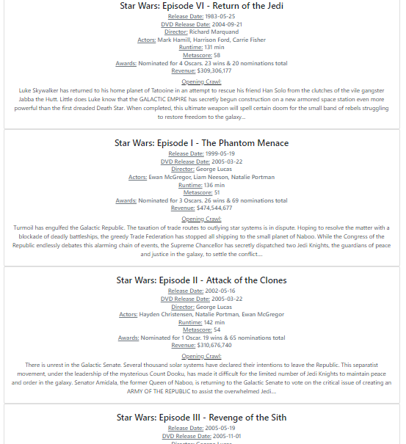

Slide 15


Set Backs
“You have failed me for the last time.”

Slide 16


Slide 17



